Slide 1
Centennial Theatre
Where Everyone Belongs

Slide 2
Welcome to the 2024/2025 Centennial Theatre Information Meeting

Slide 3
Centennial Theatre is Directed and Produced by….
Eric Webster –
Middle School and High School Play and Musical Co-Director and Technical Director
Middle School and High School Improv
Middle School Speech Coach
High School One Act Co-Director
Centennial Youth Theater Director and Technical Director
C.A.S.T. Summer Shakespeare Co-Director and Technical Director
Aperion Artistic Director
Monologue Workshop Cabaret Director
Classic Movie Club Coordinator
Centennial District Performing Arts Centers Coordinator
Laurie Tangren –
Middle School Play and Musical Co-Director
High School and Middle School play and Musical Costumer
Kris Schmidt -
Middle School and High School Set and
Props Designer and Director
Mary Rudquist –
Middle School Musical Music Director
High School Musical Co-Director
Melissa Krieger -
High School Musical Music Director
Theater Beyond Director
Shanan Custer –
One Act Cp-Director
C.A.S.T. Summer Shakespeare Co-Director
Marley Ritchie
Middle School and High School Musical Choreographer

Slide 4
Middle School Student Directors
Riley Eckman

Slide 5
The Booster Board and Leads
President Melissa Carlson
Vice President: Brandy Eckman
Treasurer: Sarah Bushnell
Secretary: Lisa Partyka
Marketing/Promotions and Fundraising Lead: Brandy Eckman
Lobby Decor Designer/Director: Melissa Carlson
Silent Auction Lead: Nikki Kalvin
Tech Week Meal Committee: Lorne and Marianne Knutson
Backstage Parent Lead: Trent Carlson
Flower Lead: Sarah Mulder
Merchandising Lead: Brandy Eckman & Lisa Partyka
Luke Hooper concessions lead

Slide 6
Centennial Theatre reminds you to
Download the BAND App!
Important communication from directors and boosters in the BAND app along with calendar updates.
This applies to all middle school and high school students and their families.

Slide 7
Follow Us On Social Media For Updates!

Slide 8
EVERYTHING IS AT
CentennialTheatre.org
Mandatory meetings
Auditions
Rehearsal Schedule
Forms
Performance schedules

Slide 9
Centennial Youth Theatre Program
“SHOW TBD”
ALL SCHEDULE AND REGISTRATION INFORMATION CENTENNIALTHEATRE.ORG
Two age groups.
Group 1 – Entering 2nd grade through entering 5th grade.
Group 2 – Entering 6th grade through entering 9th grade.
Group 1 week - June 9 – June 13 2025. Show on June 14.
Group 2 week - June 23 – June 27 2025. Show on June 24

Slide 10
CMS Improv Schedule 2024-2025 ALL SCHEDULE AND REGISTRATION INFORMATION CENTENNIALTHEATRE.ORG SESSION ONE - SEPTEMBER SESSION TWO - FEBRUARY SESSION THREE - MAY 3:00 – 4:40 AUDITORIUM Unless noted otherwise

Slide 11
CMS Speech Team Schedule 2024-2025 ALL SCHEDULE AND REGISTRATION INFORMATION CENTENNIALTHEATRE.ORG REHEARSALS DECEMBER 3:00 – 4:40 – CMS Auditorium SPEECH MEETS - JANUARY/FEBRUARY SPEECH MEETS ARE TENTATIVE AND SUBJECT TO CHANGE. FINAL SPEECH MEET DATES/TIMES/PLACES WILL BE CONFIRMED SOON. Minnetonka Middle School East Minnetonka Middle School West Centennial HOME Meet FRIENDS AND FAMILY PERFORMANCE Eden Prairie Finals

Slide 12
2023/2024 Middle School Theater Captains
Speech Captains
Sloane Howell
Charlotte McManus
Improv Captains
Carson Hooper
Keira Kimman
Bryn Donaldson
Charlotte McManus
Liam Kukkonen

Slide 13
Centennial Alumni Summer Stock Theatre - C.A.S.T. Presents Shakespeare Summer Theatre ALL SCHEDULE AND REGISTRATION INFORMATION CENTENNIALTHEATRE.ORG Former theater alumni and current Centennial Theatre students performed together for a summer show based on a Shakespeare production. Featuring all ages from beginning middle school to adult. Our July 2025 Productions Will Be: “A Winters Tale” and “Comedy of Errors” Directed by Shanan Custer and Eric Webster

Slide 14
Centennial Theatre End of the Year NOT a Banquet
5/30 – END OF YEAR CELEBRATION –
Theater Recognition and reveal Hullabaloo!
PAC – 5:30 – 8:00
Letters/ Medals/Recognition/Presidents/Theater Board/Next seasons shows
ALL INFORMATION CENTENNIALTHEATRE.ORG

Slide 15
Middle School 2025 Musical

Slide 16
THE MUSICAL WILL HAVE ITS OWN MANDATORY MEETING

Slide 17
Middle School 2024 Play

Slide 18
The harvest moon casts an eerie glow over Sleepy Hollow as the town readies for its 100th Harvest Festival. But within the creaky halls of Sleepy Hollow Middle School, a different kind of drama unfolds. Their annual production of the Headless Horseman legend faces a pre-show meltdown. Tensions simmer during a crucial overnight rehearsal, fueled by unsettling mishaps. Scripts vanish, props levitate, and whispers of the horseman himself echo through the halls. Is it just theatrical jitters, or has a touch of the supernatural seeped into the production? Ms. Tassie Kendrick, the determined director, and her organized student assistant, Felance McBeth, must navigate this theatrical nightmare. Don't miss The Legend of Sleepy Hollow: A Middle School Mystery, where the curtain rises on a hilarious whodunnit with a chilling twist that will leave you guessing until the very last pumpkin rolls.

Slide 19
*CREW OPPORTUNITIES *Costuming – Laurie Tangren *Make-up - TBD *Booth Crew – Eric Webster – Lights/Sound/Spotlights *Set and Props Design Crew – Kris Schmidt *Stage Managers – Talk with Mr. Webster *Run Crew – part of Set Crew *Props Master *Ushering – set crew Schedules for each crew will be posted on Centennialtheatre.org If there not there now they will be soon – get information from the crew leads

Slide 20
*CREW PARTICIPATION CAPS” Due to the high numbers of students wanting to participate on crews, we have to set a limit for number of participants. Too many participants in a crew means that there is not enough involvement or a positive experience for all the students.
MAXIMUM NUMBERS SET 12 Middle School 20 High School BOOTH 8 Middle School 8 High School COSTUMING 4 MIDDLE SCHOOL 5 HIGH SCHOOL MAKE-UP 2 or 3 for both HS and MS
IF THERE IS A NEED FOR
MAKE-UP CREW
If you participated on a crew the last show that we did, you will be on crew again for this show.
If you were not – you will be put on wait list until an opening occurs.
If you were on a wait list last year and did not get on a crew, you will be this year.
Wait list priority is based on your year in school. PLEASE CHECK YOUR EMAIL! IF YOU DON’T RESPOND WITHIN A REASONABLE AMOUNT OF TIME YOUR SPOT WILL GO TO NEXT PERSON ON LIST.
Exceptions will be determined on a case-by-case basis BOOTH CREW SHADOWS – IF Booth Crew is full and you want to “Shadow” the Booth Crew program, please notify Mr. Webster. Shadows watch and learn so they are ready when they do get on Booth Crew. BOOTH CREW TEST – STARTING THIS YEAR THERE WILL BE A BOOTH CREW TEST AT THE END OF THE SHOWS. Testing your knowledge of lighting, focusing, programming, sound board, spotlights, etc..If you are not passing these tests, your spot in booth may be given up for the next show. Consider this Booth Crew Auditions.

Slide 21
REGISTRATION FOLLOW THE LINK AT CENTENNIALTHEATRE.ORG ACTORS DON’T REGISTER UNTIL AFTER AUDITIONS CREW POSITIONS REGISTER AFTER TURNING IN FORMS TO MRS. TANGREN – YOU WILL BE NOTIFIED IF / WHEN YOU SHOULD REGISTER IF YOU ARE NOT CAST AS AN ACTOR AND WANT TO BE ON CREW TALK TO MRS. TANGREN TO SEE IF THERE ARE OPENINGS IN CREW SHOW TICKETS TICKETS FOR SHOWS GO ON SALE TWO WEEKS BEFORE OPENING NIGHT ALL TICKETS NEED TO BE PURCHASED ONLINE

Slide 22
REGISTER!!!! IF YOU DON’T REGISTER BY THE TIME REHEARSALS START YOU WILL BE REMOVED/REPLACED FROM THE CAST/CREW!!

Slide 23
*Expectations When called show up on time/ get off book on your own THERE ARE MANY COMMUNICATIONS SYSTEMS IN PLACE - KNOW THE SCHEDULE AND KNOW WHAT”S GOING ON Be on time Respect of everyone's time - come focused and ready to go. This allows for short rehearsal time frames PARENTS - Pick up your student on time - PLEASE Play well with others. RESPECT for every person in this program. We all come from different backgrounds and belief systems. We honor personal life philosophies.

Slide 24
*Expectations CONFLICTS Keep them to a minimum. Think about your schedule and conflicts and if it works with being in the programs. We are flexible and work with conflicts and are much more lenient than other activities. BUT If we approve your conflicts, we ask you honor the commitment once we have established a schedule that works for the program. PLEASE, other than emergencies, avoid last minute conflicts. If you have a job, figure it out with who you work for before committing to the program. CONFLICT MAXIMUM

Slide 25
Centennial Theatre
Where Everyone Belongs

Slide 26
CASTING AND AUDITIONS *Priority to seniors down to freshman Big Role/Small Role A mindset of a “Big role” and a “Small role” is a misconception of how theater works and an inaccurate perception. Theater is a group of people with one goal, to tell a story, and hopefully inspire, motivate, and touch an audience with that story. To accomplish that, everybody has a job to do, and if one person is not doing their job, the entire goal, the entire production, and the overall effectiveness of the goal of telling this story, can, and will, unravel. The mindset is; People do different jobs to accomplish the same goal, in which we all take equal part, responsibility, and credit for its success. So consequently, ALL roles are equally important and are treated as such by both the staff and the cast and crew. The recognition of the importance of all roles in a production is imperative to the success of a show, and recognition and understanding of that belief are tantamount and required to participate in the Centennial Theater Program. If you have a pre-conceived impression of the importance a role has to a show, or to yourself, either keep that perception to yourself for the good of, and success of this show, or consider not auditioning for this program. Any disruption to the production of the show, or the general chemistry of the team of cast and crew, that is caused by a student’s dissatisfaction with their role and participation in the show, will result in immediate consultation and meeting with the student’s family and administration and could result in immediate dismissal from the production.

Slide 27
"We don’t compare ourself to anybody else — that will steal your joy. We compare ourselves to who we were yesterday and try to be better today than we were yesterday.'' Showing up on time and working hard and being someone people like to work with and be around IS MUCH MORE IMPORTANT THAN TALENT.

Slide 28
AUDITIONS FOR THE LEGEND OF SLEEPY HOLLOW SIDES WILL BE POSTED ONLINE READ THE SIDES AND BE FAMILIAR WITH THEM BEFORE THE AUDITIONS YOU CAN AUDITION WITH SCRIPT IN HAND – BUT THE MORE FAMILIAR YOU ARE THE BETTER WE WILL HAVE PAPER COPIES OF THE SIDES AT AUDITIONS EXPECT TO BE HERE THE ENTIRE TIME OF AUDITIONS IF YOU ARE RELEASED IT DOESN’T MEAN ANYTHING IF YOU ARE ASKED TO STAY AND READ AGAIN IT DOESN’T MEAN ANYTHING SEPTEMBER 9th and 11th 3:00 – 4:40 - ATTEND JUST ONE IF you attend the 9th you MAY be asked if you can come back on the 11th – but if you can’t IT’S OK POSTING OF CAST WILL BE ONLINE ON SEPTEMBER 13th and posted outside the Library and in the trophy case at 3:00 – also on BAND APP and on Website FIRST REHEARSAL IS MANDATORY FOR ALL CAST AND CREW – SEPTEMBER 26th 6:00 – 8:00

Slide 29
Make-up Under the guidance of Mrs. Tangren Make up if needed for the show will be as follows IF you want to be the Make-up person lead, talk to Mr. Webster or Mrs. Tangren You can do your own Make-up but must be approved by Miss Tangren IF there is Specialty make up for a role required, then it IS mandatory and determined by the Directors. We will check with the student if they are ok with specialty make-up requirements before casting. You may request Make-up be applied by a Make-up Crew member if you wish. We will supply make-up for any specialty make-up that needs to be done OTHERWISE YOU MUST SUPPLY YOUR OWN MAKE UP YOU DO NOT HAVE TO WEAR MAKE-UP IF THE ROLE DOESN”T REQUIRE SPECIALTY MAKE-UP

Slide 30
Costumes
1790’s and Today

Slide 32
Cast Costume Requirements
All students must provide their own base costume. (Unless told otherwise.) Goodwill is a great place to look.
All students must provide their own dark shoes.
All base costumes are due for checking by October 30th.
Any rental pieces will be here October 31st.
All Students will take part in the “Fashion Show” November 4th.

Slide 33
Cast who play “Crew”
Black pants
Black shirt
Black Shoes
We will provide a black sweatshirt

Slide 34
Cast who play “Actors”
Black Shoes
Rental or costumes from our costumes provided
Some “Actors” will need to provide their own base costume, pants and shirt. You will be told what to provide.

Slide 35
Female – Skirt (we have the skirts) and long-sleeved blouse
Trees and Dancers Base Costumes
Male – Dark pants and long-sleeved white shirt.

Slide 36
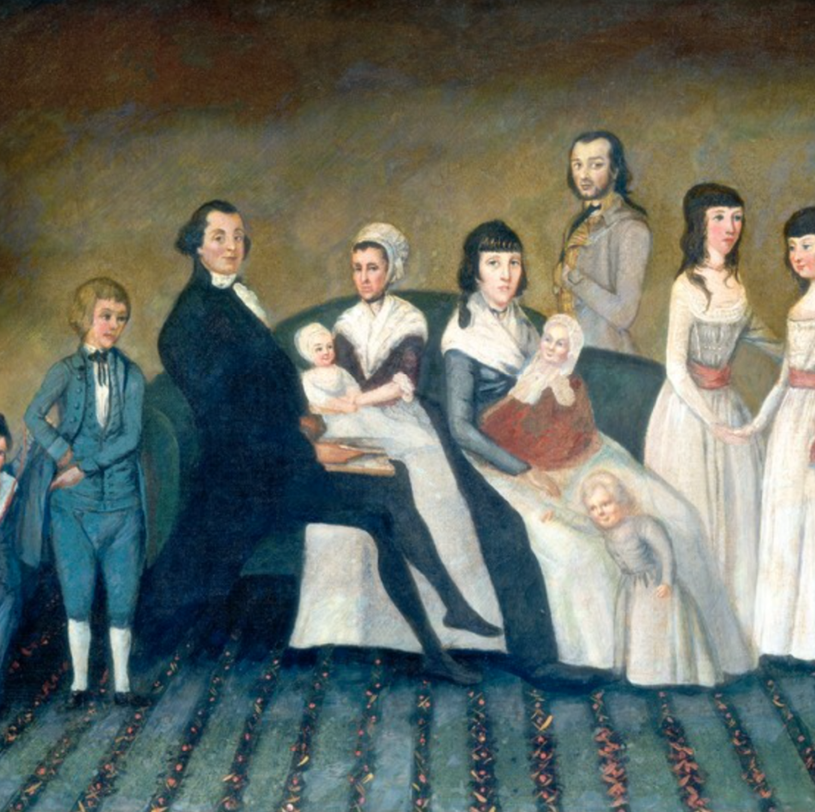
1790’s Clothing
Cotton floor-length dresses with colored sashes for women and girls were popular
Dark Shoes
Ribbons for hair
Dark suits and bolo ties for men and boys

Slide 37
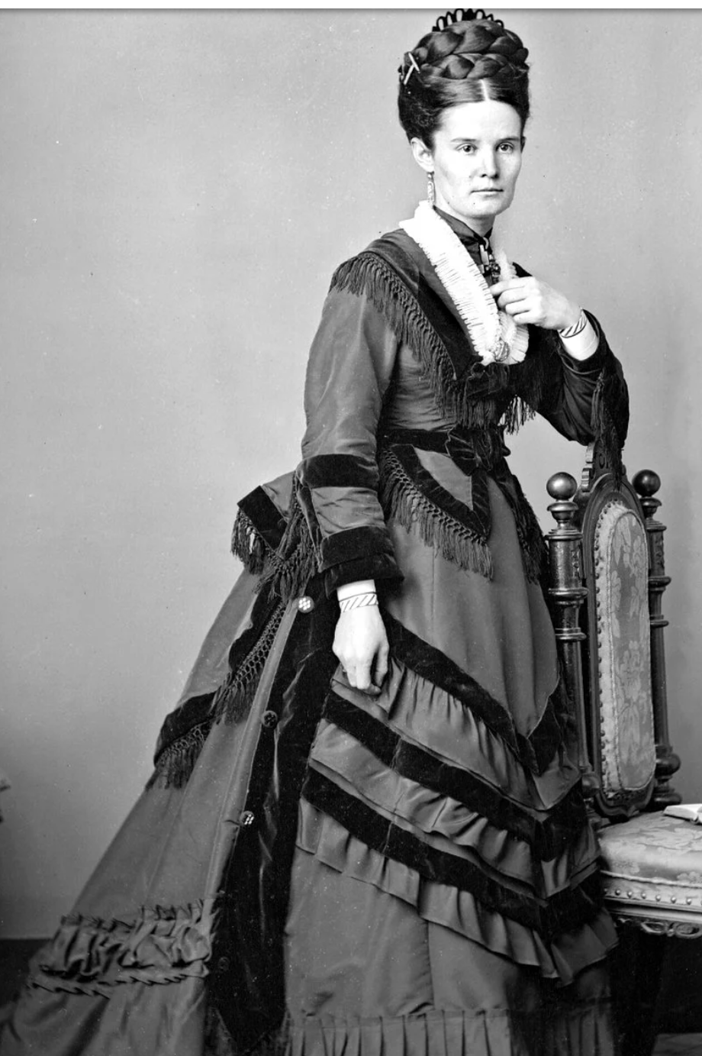
Women’s Hair
Braids and buns

Slide 38
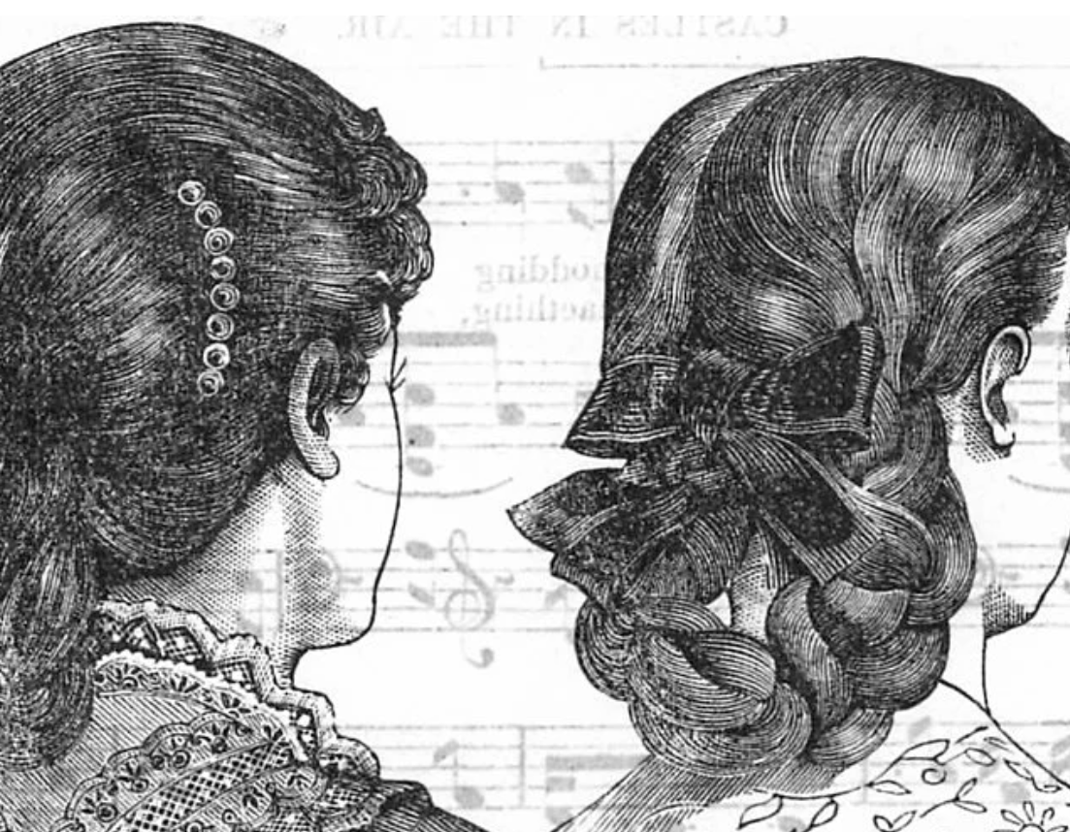
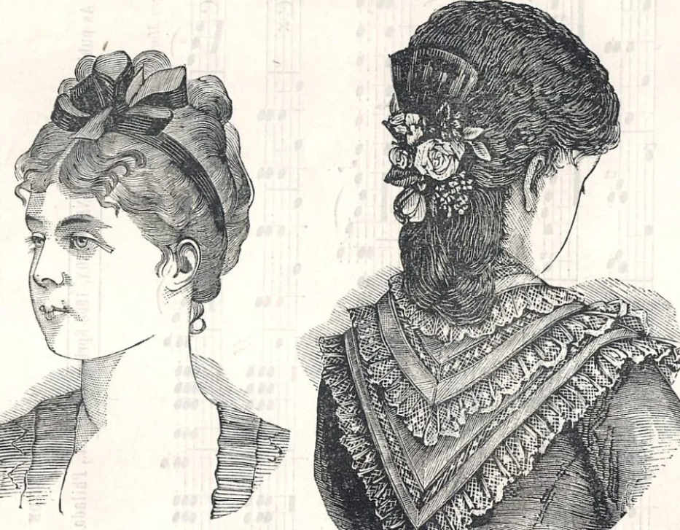
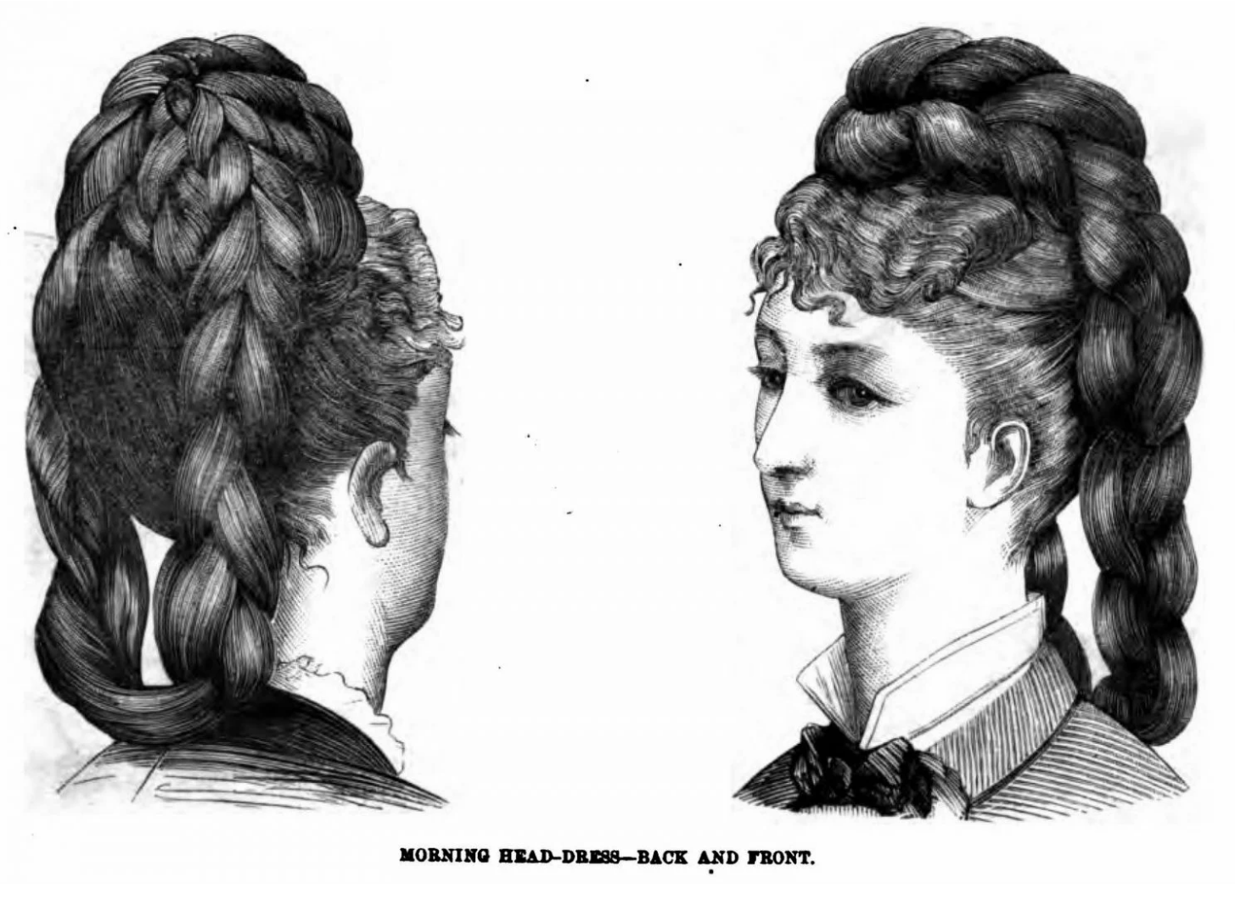
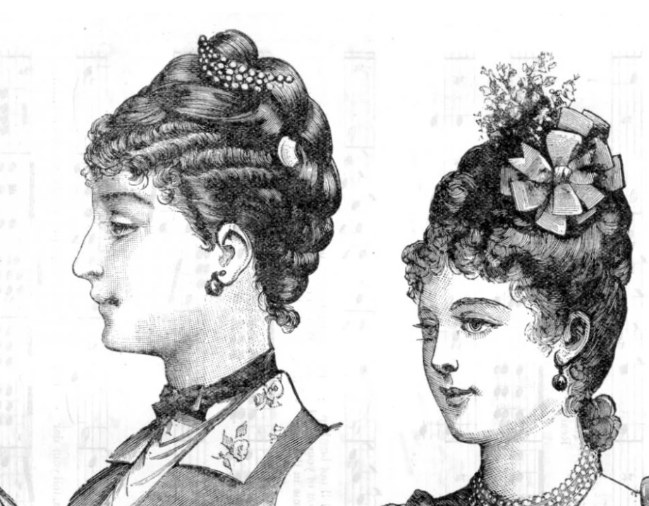
More Hair -Up or half up half down -Braids and big curls were popular

